Slide 1
Project Migration / Management

Slide 2
Project Migration
Understand the Migration Path
https://support.industry.siemens.com/cs/ww/en/view/62100731
Identify the components that make up the TIA Portal Engineering Software
Notes:
Review the migration link to learn more about the restrictions and things to look out for when converting.

Slide 3

Migration Path
S7-200 phased-out October 1, 2013
Replaced by S7-1200
S7-300 & S7-400 after 2020
Replaced by S7-1500
Notes:
Major software development has stopped on Step 7 Classic.
Users should be planning for migration at this time.

Slide 4
Compatibility
Windows 7
Windows 8.1
Windows 10
32Bit
Classic
64Bit
+ Windows Server 2008 R2 SP1
32Bit
TIA Portal V14
64Bit
+ Windows Server 2008 SP1
+ Windows Server 2012 R2

Slide 5




Controller Portfolio
Advanced Controller
Unique power thanks to high performant backplane bus, shortest clamp-to-clamp reaction time and fastest signal processing
Highest level of user-friendliness
Software Controller
PC-based controller for use on SIMATIC IPCs
Runs independently: Restart of Windows while controller in run.
PC-based controller for use on SIMATIC IPCs
Runs independently: Restart of Windows while controller in run.
Distributed Controller
Space-saving distributed controller
Combines the benefits of S7-1500 with the layout of ET 200SP.
Basic Controller
Compact controller, failsafe also!
Modular expandable
Wide range of integrated technology functions.
Notes:
Advanced Controllers – what we normally consider when discussing PLCs
Software Controllers – referred to as soft controllers, are installed on PC har.dware. The user program is written and downloaded just like a traditional PLC.
Distributed Controllers – Lower end CPUs that attach directly to distributed IO. These are programmed like a traditional PLC.
Basic Controllers – Simple controllers with limited instruction set. Programmed like a traditional PLC but are the bridge between “relay replacer” PLCs (Siemens LOGO!) and other controllers.

Slide 6

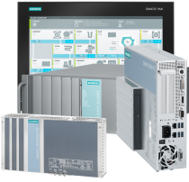

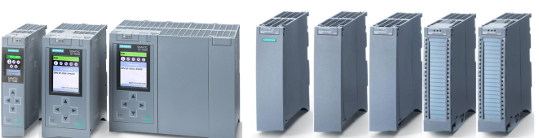
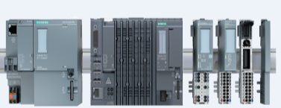
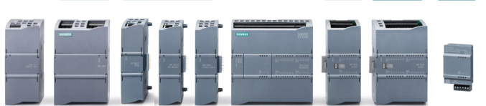
Controller Portfolio
Advanced Controller (S7-1500)
Software Controller S7-1500
CPU
Interface modules
Power supply
Communication modules
Signal modules
Technology modules
Basic Controller (S7-1200)
Distributed Controller (ET 200SP CPU)
Switch modules
Power supply
Communication modules
CPU
Signal modules
Technology modules
Signal boards
CPU
ET 200SP modules

Slide 7
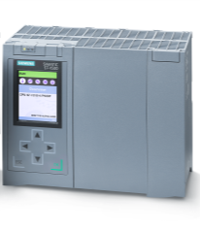
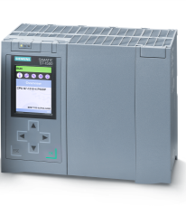
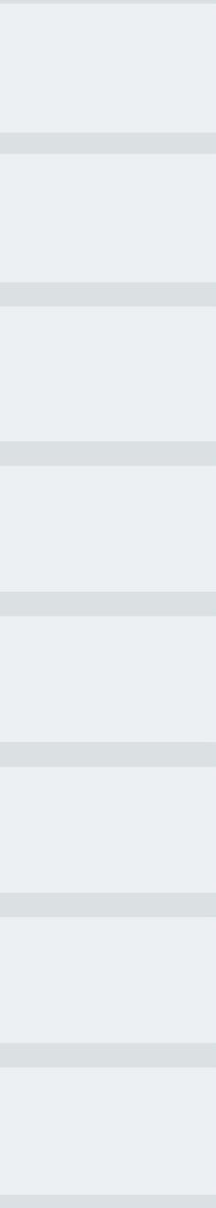
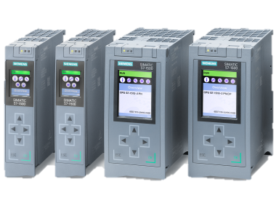
Standard S7-1500 CPU
CPU 1511-1 PN … CPU 1518-3 PN/DP
S7-1500 CPU Portfolio
1518
1517
416-2
7-3
7-3
319-3 PN/DP
414-3 PN/DP
1516
317-2 PN/DP
414-3
317-2 DP
414-2
1515
315-2 PN/DP
412-2 PN/DP
1513
315-2 DP
412-2
1511
314
412-1
312
German list price in €, regional adjustment may differ!
1,000
2,000
3,000
4,000
5,000
6,000
7,000
S7-1500

Slide 8
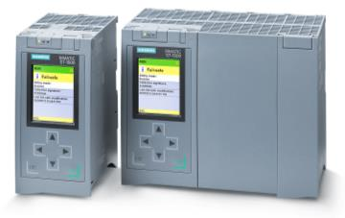
Failsafe S7-1500 CPU
CPU 1511F-1 PN … CPU 1518F-3 PN/DP
1518F
1517F
416F-2
319F-3 PN/DP
414F-3 PN/DP
1516F
317F-2 PN/DP
317F-2 DP
1515F
315F-2 PN/DP
1513F
315F-2 DP
1511F
German list price in €, regional adjustment may differ!
1,000
2,000
3,000
4,000
5,000
6,000
7,000
S7-1500

Slide 9
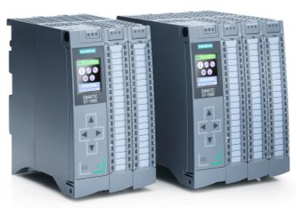
Compact S7-1500 CPU
SIMATIC CPU 1511C-1 PN / 1512C-1 PN
Notes:
S7-300C incl. IO connector (Push-In)
CPU 313C has more IOs than CPU 1511C
1512C
314C-2 PN/DP
314C-2 DP
314C-2 PtP
1511C
313C-2 DP
313C-2 PtP
313C
312C
S7-1500
German list price in €, regional adjustment may differ!
500
1,000
1,500

Slide 10
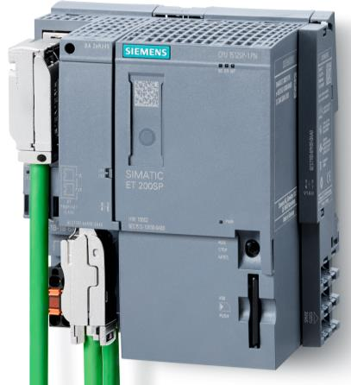
Distributed Controllers ET200SP
CPU 1510SP-1 PN / CPU 1510SP F-1 PN CPU 1512SP-1 PN / CPU 1512SP F-1 PN

Slide 11
TIA Portal Overview of the functional scope of the products
SIMATIC STEP 7
SIMATIC WinCC
SINAMICS Startdrive
Programming Languages
LAD, FBD, SCL, STL*, S7-Gragh*
Option STEP 7 Safety
Machine-level operator control and monitoring
SCADA applications
Drive configuration,
commissioning, diagnostics
WinAC
Professional
SCADA
Professional
G120
Startdrive
S7-1500
Advanced
PC Single User
G120D
S7-300 / S7-400
ET200 CPU
Comfort Panels
Comfort
G120P
S7-1200
Basic
Basic Panels
Basic
G120C
Communication
- Profibus, Profinet, network topology, (AS-I, IO-Link)
Shared functions
- System diagnostics, import/export to/from Excel, undo …..
*Only in Professional for S7-300/400/1500/WinAC
Notes:
The TIA Portal is an engineering framework that combines PLC and HMI engineering into a single package. The three components of the TIA Portal are the PLC engineering software STEP7, the HMI engineering software WinCC, and the Drives engineering software Startdrive.
Step 7 – Engineering software for 1200, 1500 and WinAC. Additionally 300 and 400 can be programmed.
Basic – A master disk licensed product programs the 1200. LAD FBD SCL
Professional – several licenses are available for the different version and packages. Used to program 1200, 1500, WinAC, 300 and 400. Additionally STL and S7-Graph
WinCC – Engineering Software for all levels of HMI.
Basic – For use with Basic Panels. Master Disk License. License included with both Step7 License levels.
Comfort – Adds support for Comfort Panels
Advanced – Adds PC Runtime development
Professional – includes all other devices and full SCADA HMI solutions.
Startdrive – Engineering of Siemens drives. As of V13 G110, and G120 supported. S120 Planned for V14.

Slide 12
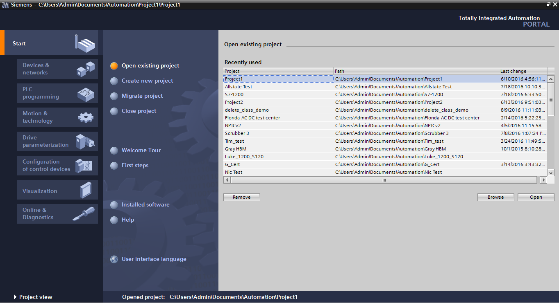
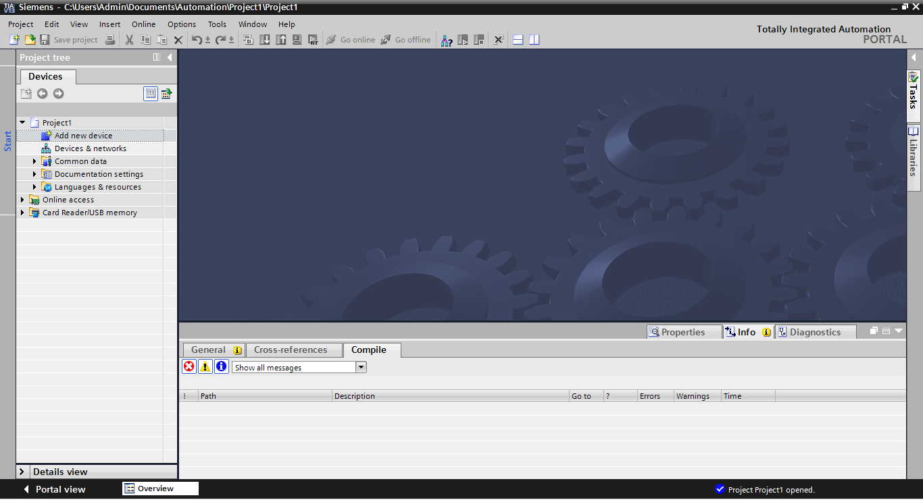
Portal and Project View
Project View
Portal View
Notes:
Switching between views can be done with the link in the lower left corner.
Switching permanently between views can be done;
Options → Settings → General → General → Start View

Slide 13
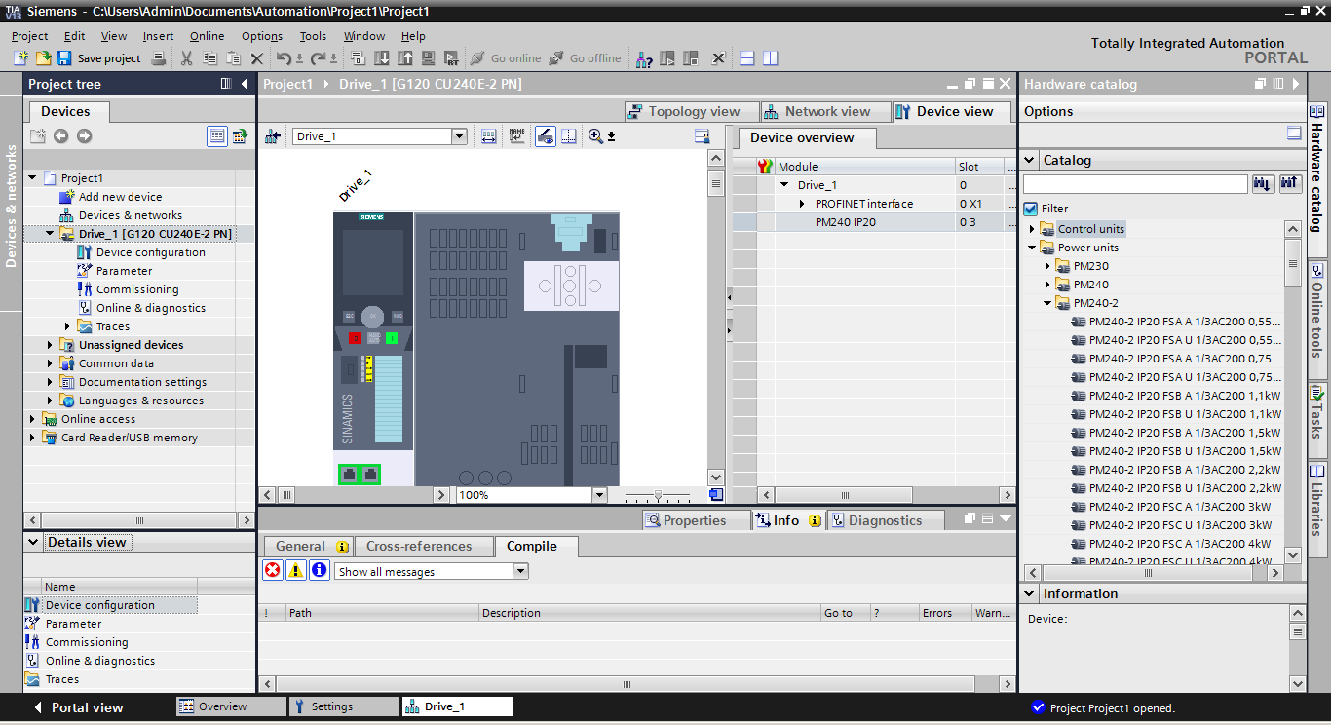
Project View Objects
Project Tree
Working Area
Task Cards
Inspector Window
Details Window
Notes:
Project Tree – Blocks, devices, traces and connectivity are found in the project tree
All other areas change based on what is selected on the screen.
Detail Window - Shows details regarding the selected item
Working Area – Area where hardware is assembled, code is written
Inspector Window – most parameterization is done is this area.
Task Cards – These are hardware libraries, instruction libraries and user developed faceplates, to name a few.
All windows can be floated, docked hidden, and minimized.

Slide 14
Lab Exercises

Slide 15
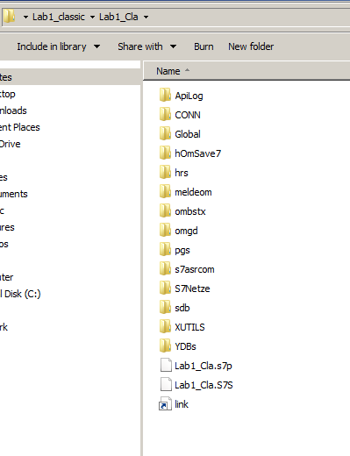
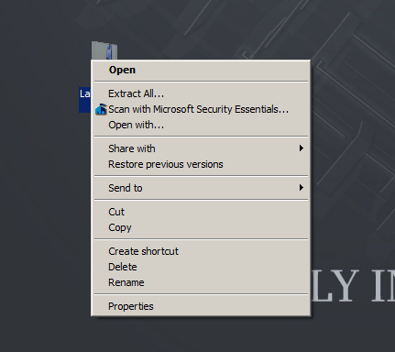
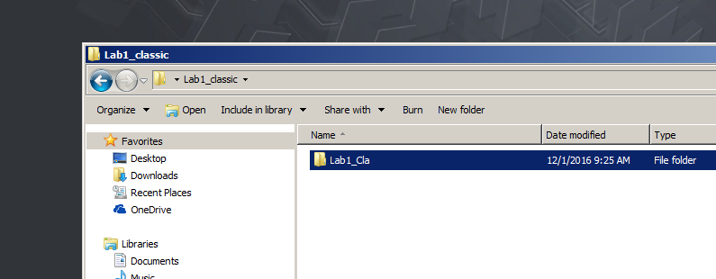
Lab1.1 – Migrate Classic Application
Notes:
Extract the Classic Archive to the Desktop
Note the old file structure

Slide 16
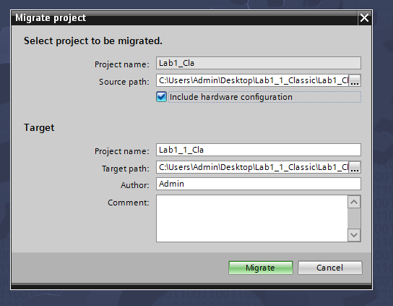
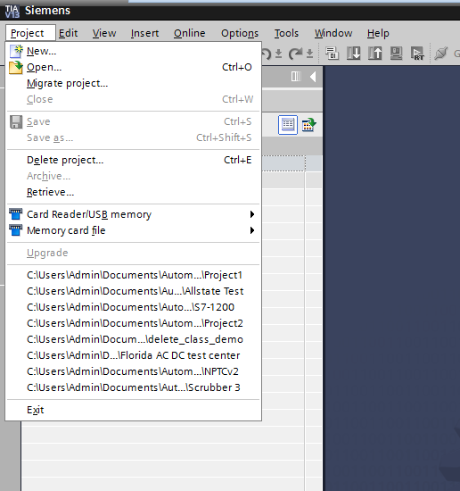
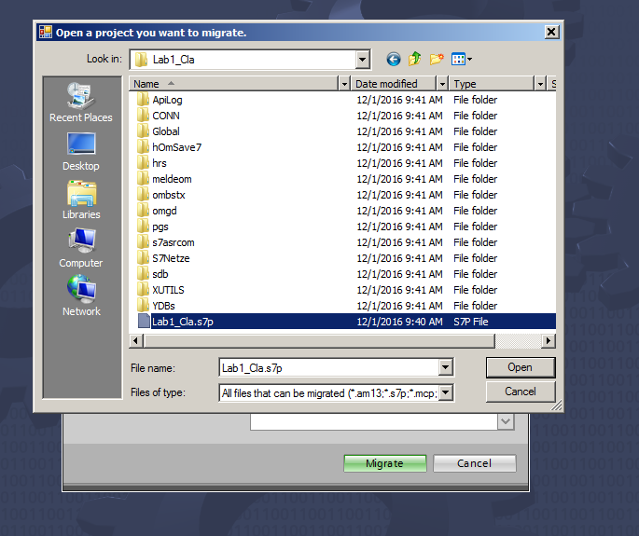
Notes:
Open Portal
Click Project → Migrate Project
Find the classic application - *.s7p
Be sure to check to include hardware configuration
Click Migrate

Slide 17
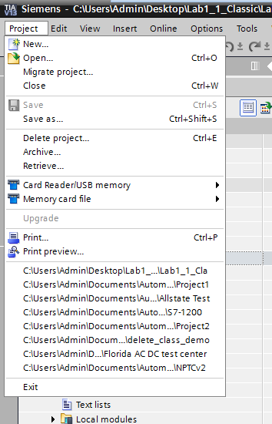
Lab1.2 – Archive and Retrieve
Notes:
Archive the project
Click Project → Archive
Archives despite the file extension are simply windows zip files.
Close the project
Click Project → Close
Retrieve the project
Click Project → Retrieve

Slide 18
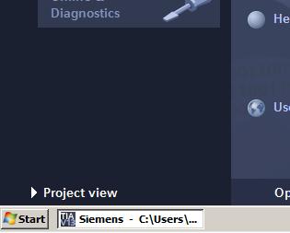
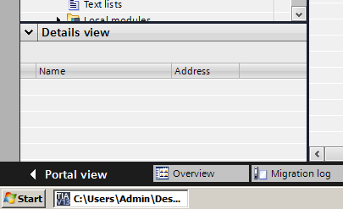
Lab1.3 – Portal View / Project View
Notes:
Note the difference between the Portal View and the Project view
Spend some time observing the differences.

Slide 19
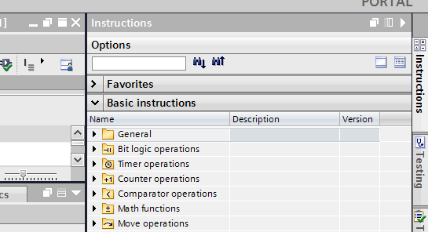
Lab 1.4 – Float and Dock Windows
Notes:
Float the work window, auto hide the task cards, and Inspector Windows
Discover how the windows behave.

